Slide 1
Introduction
Dynamic Programming is a powerful technique used in Computer Science and Engineering (CSE) to solve optimization problems by breaking them down into simpler, overlapping subproblems and efficiently solving each subproblem only once, storing the solutions for future reference. This approach helps avoid redundant computations, leading to significant improvements in time and space complexity.
Basic Concepts:
Optimization Problems:
Dynamic Programming is commonly applied to optimization problems, where the goal is to find the best solution among a set of feasible solutions.
Overlapping Subproblems:
Dynamic Programming breaks down a complex problem into smaller subproblems.
The solutions to these subproblems overlap, meaning the same subproblem may be solved multiple times. Dynamic Programming optimally stores and reuses these solutions.

Slide 2
Memoization:
Memoization is a key technique in Dynamic Programming. It involves storing the results of expensive function calls and returning the cached result when the same inputs occur again.
Tabulation:
Instead of using memoization, some Dynamic Programming algorithms use tabulation to build a table of solutions bottom-up, starting from the simplest subproblems and gradually solving more complex ones.
Steps to Solve a Dynamic Programming Problem:
1. Define the Structure of Optimal Solutions: Identify the decision variables and parameters that define the optimal solution.
2. Characterize the Value of an Optimal Solution: Define the value of an optimal solution recursively in terms of the values of smaller subproblems.
3. Define the Recurrence Relation: Formulate a recurrence relation expressing the value of an optimal solution in terms of the values of smaller subproblems.

Slide 3
4. Base Cases: Identify the base cases or smallest subproblems that can be solved directly without further decomposition.
5. Memoization or Tabulation: Implement the solution using memoization or tabulation to avoid redundant computations.
6. Construct the Optimal Solution: Once the table is filled, construct the optimal solution from the computed values.
Examples of Dynamic Programming Problems:
1. Fibonacci Sequence
2. Longest Common Subsequence
3. Knapsack Problem
4. Shortest Paths
5. Matrix Chain Multiplication
6. Rod Cutting Problem

Slide 4
Knapsack Problem-
You are given the following-
A knapsack (kind of shoulder bag) with limited weight capacity.
Few items each having some weight and value.
The problem states-
Which items should be placed into the knapsack such that-
The value or profit obtained by putting the items into the knapsack is maximum.
And the weight limit of the knapsack does not exceed.

Slide 5
Knapsack Problem-
Knapsack Problem Variants-
Knapsack problem has the following two variants-
Fractional Knapsack Problem
0/1 Knapsack Problem

Slide 6
Knapsack Problem-
Fractional Knapsack Problem Using Greedy Method-
For each item, compute its value / weight ratio.
Arrange all the items in decreasing order of their value / weight ratio.
Start putting the items into the knapsack beginning from the item with the highest ratio.
Put as many items as you can into the knapsack

Slide 7
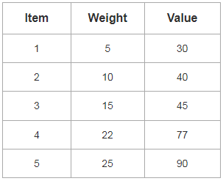
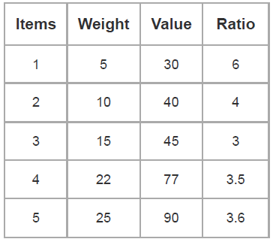
Knapsack Problem-
Problem-
For the given set of items and knapsack capacity = 60 kg, find the optimal solution for the fractional knapsack problem making use of greedy approach
Step-01:
Compute the value / weight ratio for each item-

Slide 8

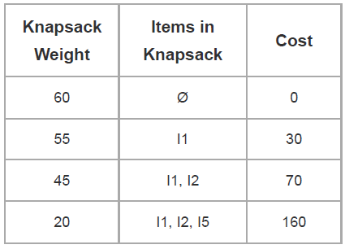
Knapsack Problem-
Step-02:
Sort all the items in decreasing order of their value / weight ratio-
Step-03:
Start filling the knapsack by putting the items into it one by one.

Slide 9
Knapsack Problem-
Now,
Knapsack weight left to be filled is 20 kg but item-4 has a weight of 22 kg.
Since in fractional knapsack problem, even the fraction of any item can be taken.
So, knapsack will contain the following items-
< I1 , I2 , I5 , (20/22) I4 >
Total cost of the knapsack
= 160 + (20/27) x 77
= 160 + 70
= 230 units

Slide 10

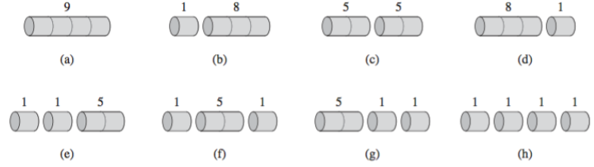
Rod cutting
Suppose you have a rod of length n, and you want to cut up the rod and sell the pieces in a way that maximizes the total amount of money you get. A piece of length i is worth pi dollars.
8 possible ways of cutting the rod of length 4 are.

Slide 11
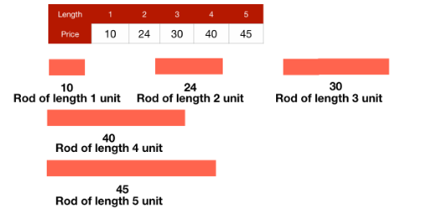
Rod cutting
According to the problem, we are provided with a long rod of length n units.
We can cut the rod in different sizes and each size has a different cost associated with it i.e., a rod of i units length will have a cost of ci$.
Let's look at the table given below showing the cost v/s length of the rod.

Slide 12

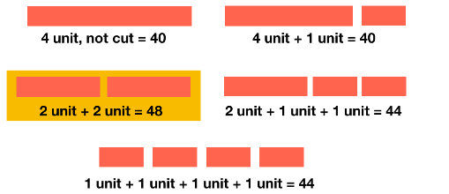
Rod Cutting
Let's take a case when our rod is 4 units long, then we have the following different ways of cutting it.
So, we have to choose between two option for a total of n-1 times and thus the total possible number of solutions are

Slide 13
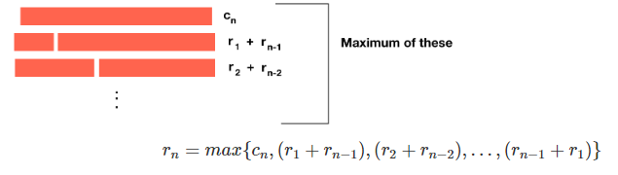
Rod Cutting
For example, by selling the smaller pieces at the optimal price, we are generating maximum profit from the bigger piece. This property is called optimal substructure.
We can say that when making a cut at i unit length, the maximum revenue can be generated by selling the first unit at ri$ and the second unit at rn−i$.
The maximum revenue for a rod of length n (rn) will be the maximum of all these revenues.

